Slide 1
Sunitha R
Assistant Professor
Department of Computer Science Engineering
PES University, Bangalore

Slide 2
Decentralized Application Design
The best way to learn any new technology is by diving in and building simple applications.
Let’s build a Simple Voting application.

Slide 3
Objective
Set up the development environment.
Contact design
Enable people to vote

Slide 4
Problem Statement
There are 10 candidates participating in election.
Anyone can vote for any participating candidate.
Once the voting has been done, no one else can change the vote (Immutability).
All the candidates and voters can see the vote count transparently.
We write contract to
Increment vote count for a candidate.
Return the total votes a candidate has received.

Slide 5


DApp Design
Command line Terminal / Web Browser
RPC
Voting App
Nodejs/Web3js
EVM
Blockchain
B1
B2
B3
B10

Slide 6
Step-1: Set up the development environment
Install 1-Node Package Manager (npm)
NPM is a package manager for Node.js packages or modules
steps to install npm
https://www.npmjs.com/get-npm

Slide 7

Set up the development environment
Install 2- Ganache-cli
It is a in- memory blockchain
Ganache (earlier TestRPC) is a personal blockchain for Ethereum development that developers can use to deploy contracts, develop applications, and run tests.
It runs locally, simulates a full Ethereum.
Command to install ganache
npm install -g ganache-cli

Slide 8

Set up the development environment
Install 3- Truffle
Truffle is a development environment, testing framework, and asset pipeline for blockchains using the Ethereum Virtual Machine (EVM).
It helps you deploy your contracts to the blockchain.
It swap old contracts for new ones (called a migration).
It hook your front-end up to your deployed contracts.
Command to install truffle
npm install -g truffle

Slide 9
Set up the development environment
Check the version of npm: npm -v
Check the version of npm: node -v
Create a directory for Dapp: mkdir voting_dapp
cd voting_dapp
Install-5: web3js console
npm install web3@1.2.6
Install-6: npm module called solc
npm install solc@0.6.4

Slide 10
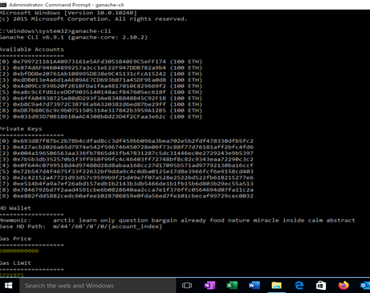
Step-2: Start Ganache-cli
Start up the client and generate 10 accounts for you to use, each with 100 ETH
ganache-cli
First list is the public addresses of each of the 10 accounts
Second list is the private keys associated with each account

Slide 11
Step-3: Simple voting contract
Solidity programming language is used to write this contract.
Writing a contract called Voting with a constructor which initializes an array of candidates.
Following 2 methods for writing contracts,
one to return the total votes a candidate has received.
another method to increment vote count for a candidate.
Voting.sol
Copy the above code to a file named filename.sol in the voting_dapp directory
Compile the code and deploy it to ganache blockchain.

Slide 12
M1: Simple voting contract
To compile the solidity code of the contract
cd node_modules
cd .bin
solcjs --bin --abi Voting.sol
When you compile the code successfully using the command above, the compiler outputs 2 files that are important to understand:
Voting_sol_Voting.bin
Voting_sol_Voting.abi
Notes:
Voting_sol_Voting.bin: This is the bytecode you get when the source code in Voting.sol is compiled. This is the code which will be deployed to the blockchain.
Voting_sol_Voting.abi: This is an interface or template of the contract (called abi) which tells the contract user what methods are available in the contract. Whenever you have to interact with the contract in the future, you will need this abi definition.

Slide 13
Simple voting contract
Run the ‘node’ command in your terminal to get into the node console
node
Initialize the web3 object
Web3 = require('web3’)
Communicate with the blockchain
web3 = new Web3("http://localhost:8545")

Slide 14
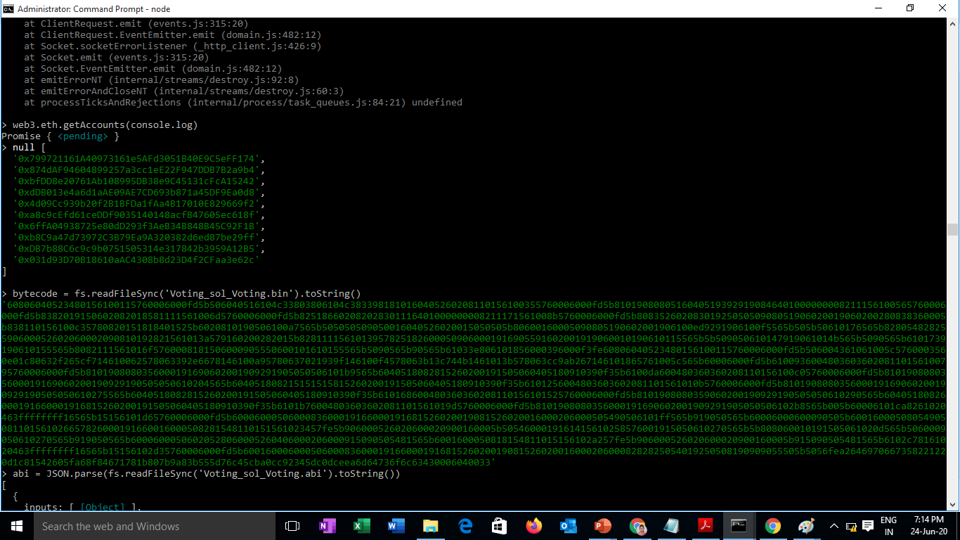
Simple voting contract
Query all the accounts in the blockchain
web3.eth.getAccounts(console.log)

Slide 15
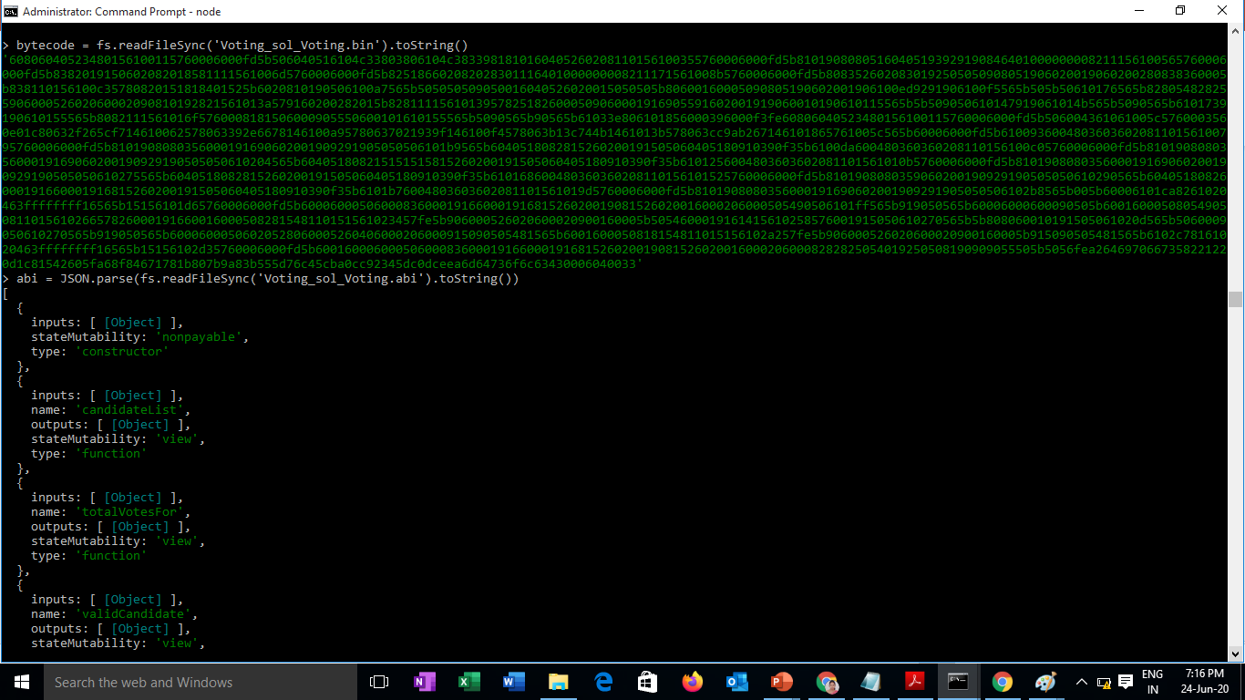
Step-4: Compile voting contract
To compile the contract, load the bytecode and abi from the file system into a string
bytecode = fs.readFileSync('Voting_sol_Voting.bin').toString()
abi = JSON.parse(fs.readFileSync('Voting_sol_Voting.abi').toString())

Slide 16
Step-5: Deploy the contract
deployedContract = new web3.eth.Contract(abi)
listOfCandidates = ['Rama', ‘sham', ‘Rani’]
deployedContract.deploy({
data: bytecode, arguments: [listOfCandidates.map(name => web3.utils.asciiToHex(name))] }).send({ from:’0xaae36d4150DBdC067Ef280d1D8B19551e6c3dBbF’, gas: 1500000, gasPrice: web3.utils.toWei('0.00003', 'ether') }).then((newContractInstance) => { deployedContract.options.address = newContractInstance.options.address console.log(newContractInstance.options.address) });
1 OF 10 ACCOUNT ADDRESSES like 0xfb3....

Slide 17
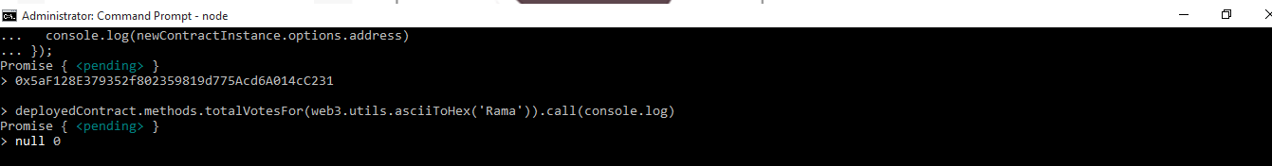
Step-6: Interact with the contract in the nodejs console
deployedContract.methods.totalVotesFor(web3.utils.asciiToHex('Rama')).call(console.log)

Slide 18
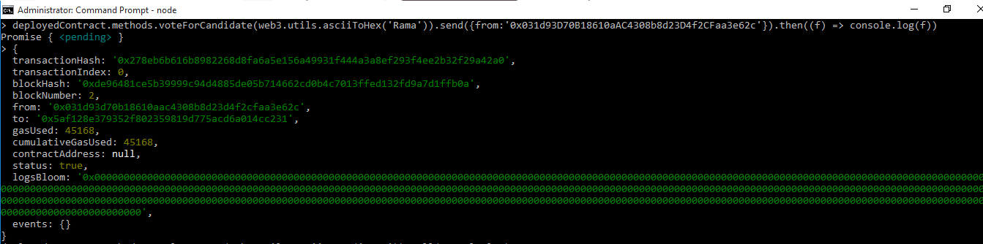
Interact with the contract in the nodejs console
deployedContract.methods.voteForCandidate(web3.utils.asciiToHex('Ram')).send({from: 'YOUR ACCOUNT ADDRESS'}).then((f) => console.log(f))
1 OF 10 ACCOUNT ADDRESSES like 0xfb3....

Slide 19
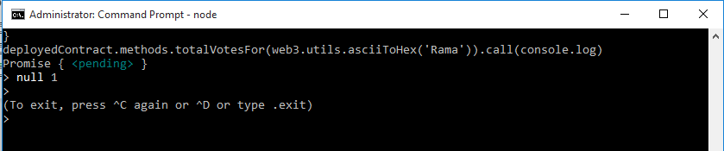
Interact with the contract in the nodejs console
deployedContract.methods.totalVotesFor(web3.utils.asciiToHex('Rama')).call(console.log)

Slide 20
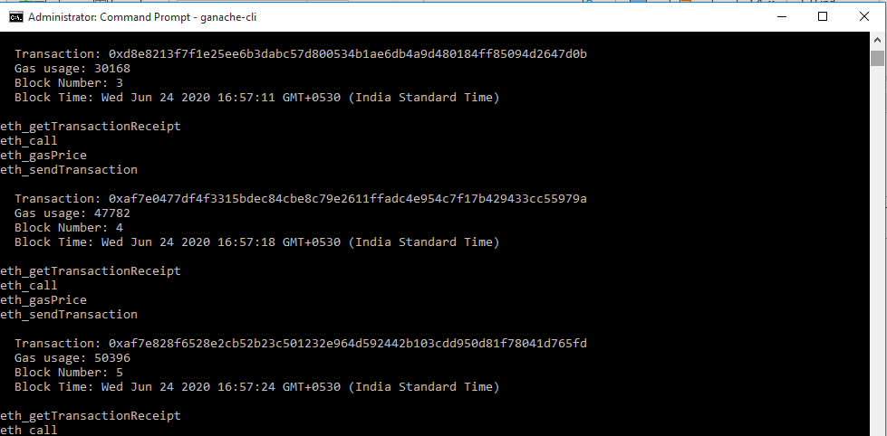
Interact with the contract in the nodejs console
This transaction id is the proof that this transaction occurred
It can refer at any time in the future.
This transaction is immutable.

Slide 21
M2: Webpage to connect to the blockchain and vote
Create a simple html file with candidate names and invoke the voting in a js file.
Create the html code and the js file.
Drop both in the voting_dapp directory and
open the index.html in your browser.

Slide 22
Webpage to connect to the blockchain and vote
index.html code
Index.js file
Need the abi and the address to interact with any contract.

Slide 23
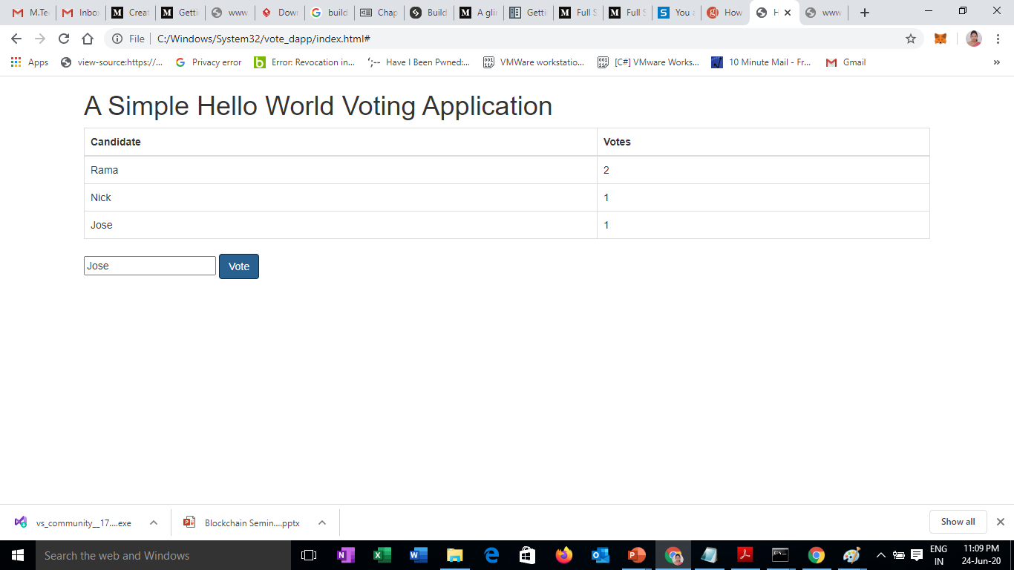
Webpage to connect to the blockchain and vote

Slide 24
Supplementary readings
https://ethereum.org/en/
https://www.youtube.com/watch?v=jxLkbJozKbY

Slide 25
Webpage to connect to the blockchain and vote

Slide 26
Sunitha R
Assistant Professor
Department of Computer Science Engineering
PES University

